Slide 1
Employee Data Analysis using Excel
STUDENT NAME: N.SRIDHARINI
REGISTER NO: 312216424(asunm1621312216424)
DEPARTMENT: 3RD BCOM COMPUTER APPLICATION
COLLEGE: SHRI SHANKARLAL SUNDARBAI SHASUN JAIN COLLEGE
FOR WOMEN

Slide 2
PROJECT TITLE
Employee Performance Analysis using Excel

Slide 3


AGENDA
Problem Statement
Project Overview
End Users
Our Solution and Proposition
Dataset Description
Modelling Approach
Results and Discussion
Conclusion
3/21/2024 Annual Review

Slide 4

PROBLEM STATEMENT
HR department needs a standardized and efficient method to assess employee performance across various departments. The current manual evaluation process is inconsistent and lacks clarity. By implementing an Employee Performance Analysis using Excel, the HR team aims to track key performance indicators (KPIs) such as task completion, sales figures, and attendance. The goal is to provide actionable insights for fair and transparent performance reviews, helping management make data-driven decisions on promotions, training, and resource allocation.

Slide 5

PROJECT OVERVIEW
The project focuses on analyzing employee performance data to identify any gender-based disparities. Using an Excel dataset that includes various employee metrics such as performance scores, ratings, and job functions, the analysis aims to uncover trends and differences between male and female employees. Key tasks include data cleaning, descriptive statistics, comparative analysis, and visualizations to highlight performance trends. Statistical tests will be conducted to determine if observed differences are significant. The outcomes will provide insights into potential gender-based performance disparities, leading to recommendations for more equitable performance evaluations. The project will deliver a comprehensive report, an Excel workbook with analysis, and a presentation of findings

Slide 6

WHO ARE THE END USERS?
Human Resources (HR) Department
Management and Executives
Diversity, Equity, and Inclusion (DEI) Teams
Employees
External Auditors or Consultants
Organizational Development Teams

Slide 7

OUR SOLUTION AND ITS VALUE PROPOSITION
Solution
Our solution leverages advanced data analysis techniques, including conditional formatting, filtering, and custom formulas, to accurately calculate and visualize performance levels.
Value Proposition:
By using our solution, businesses can effortlessly monitor and enhance their performance metrics. The conditional formatting highlights key insights, filtering allows for focused analysis, and our formula-driven calculations provide precise performance evaluations, enabling informed decision-making and continuous improvement.

Slide 8
Dataset Description
FirstName: Text
LastName: Text
StartDate: Text (Date format)
ExitDate: Text (Date format)
Title: Text
Supervisor: Text
ADEmail: Text
BusinessUnit: Text
EmployeeStatus: Text
EmployeeType: Text
PayZone: Text
EmployeeClassificationType: Text
TerminationType: Text

Slide 9
DepartmentType: Text
Division: Text
DOB: Text (Date format)
State: Text
JobFunctionDescription: Text
GenderCode: Text
LocationCode: Text
RaceDesc: Text
MaritalDesc: Text
Performance Score: Numerical
Current Employee Rating: Numerical
Performance Level: Text

Slide 10

THE "WOW" IN OUR SOLUTION
The wow factor in this project lies in its use of advanced statistical techniques and predictive analytics to uncover and forecast gender-based performance disparities. The project also features interactive dashboards for real-time data exploration, providing stakeholders with dynamic insights. Additionally, it includes actionable recommendations that are benchmarked against industry standards, ensuring practical and impactful outcomes. The analysis doesn't just identify disparities; it emphasizes the broader ethical and diversity impacts, positioning the findings as a catalyst for positive change within the organization.
3/21/2024 Annual Review
‹#›

Slide 11
MODELLING
Creating a detailed step-by-step procedure for downloading an employee dataset and analyzing it for performance in 220 lines involves outlining each stage of the process, from data acquisition to the final analysis and results. Here’s a structured approach:
Step 1: Downloading the Employee Dataset
1.Identify the Data Source: - Determine where the employee dataset is stored (e.g., company database, HR software, online repository).
2. Access the Data Source - Log in to the system or platform where the data is hosted.
3. Select the Dataset: - Navigate to the appropriate section to find the employee dataset.
4. Choose File Format:
- Select the preferred format for downloading (e.g., CSV, Excel, JSON).
5. Download the File:
- Click the download button and save the dataset to your local machine.
.
‹#›

Slide 12
Step 2: Preparing the Dataset
6. *Open the Dataset:*
- Use a spreadsheet application (e.g., Excel) or a data analysis tool (e.g., Python, R) to open the downloaded file.
7. *Review Data Structure:*
- Check the dataset for the number of rows and columns, and ensure that all relevant data fields (e.g., employee ID, name, performance metrics) are present.
8. *Clean the Data:*
- Remove any unnecessary columns or rows, such as empty cells or irrelevant data.
- Handle missing data by either filling in, interpolating, or removing records.
9. *Standardize Data Formats:*
- Ensure all data is in a consistent format (e.g., date formats, numerical values).
10. *Validate Data Integrity:*
- Cross-check the data for any inconsistencies or errors that might affect analysis.

Slide 13
Step 3: Data Transformation and Processing
11. *Filter the Data:*
- Apply filters to focus on specific time periods, departments, or employee groups.
12. *Sort the Data:*
- Sort employees by performance metrics or other criteria to prioritize analysis.
13. *Create Calculated Columns:*
- Add new columns to calculate additional metrics, such as performance ratios, averages, or deviations.
14. *Apply Conditional Formatting:*
- Highlight key performance indicators (KPIs) using color codes to easily identify high and low performers.
15. *Group Data:*
- Group employees by department, role, or other categories to enable comparative analysis.

Slide 14
Step 4: Analyzing Employee Performance
16. *Calculate Performance Levels:*
- Use formulas to calculate overall performance levels, taking into account metrics such as sales targets, project completion rates, and customer satisfaction scores.
17. *Create Summary Statistics:*
- Generate summary statistics (e.g., mean, median, mode) for key
performance metrics.
18. *Identify Performance Trends:*
- Analyze the data to spot trends, such as improving or declining performance over time.
19. *Compare Against Benchmarks:*
- Compare employee performance against industry benchmarks or internal standards.
20. *Visualize the Data:*
- Create charts, graphs, and dashboards to visually represent performance levels and trends

Slide 15
Step 5: Drawing Conclusions and Making Recommendations
21. *Summarize Key Findings:*
- Write a summary of the most important insights from the analysis, including high-performing employees and areas needing improvement.
22. *Identify Areas for Improvement:*
- Highlight specific areas where employee performance could be enhanced, such as through additional training or process changes.
23. *Provide Actionable Recommendations:*
- Offer concrete suggestions for improving performance, such as new performance metrics, incentive programs, or team restructuring.
24. *Draft a Performance Report:*
- Compile the findings, conclusions, and recommendations into a comprehensive report for management.
25. *Share Results:*
- Present the findings to relevant stakeholders, ensuring that the data is accessible and understandable.

Slide 16
Step 6: Implementing and Monitoring Changes
26. *Set Performance Goals:*
- Based on the analysis, set new performance goals and KPIs for employees.
27. *Implement Improvement Strategies:*
- Roll out any recommended changes, such as training programs or process improvements.
28. *Monitor Progress:*
- Regularly review employee performance data to track progress toward the new goals.
29. *Adjust Strategies as Needed:*
- Make necessary adjustments to the strategies based on ongoing performance monitoring.
30. *Conduct Follow-up Analysis:*
- Periodically repeat the analysis to assess the impact of the implemented changes and ensure continuous improvement.

Slide 17
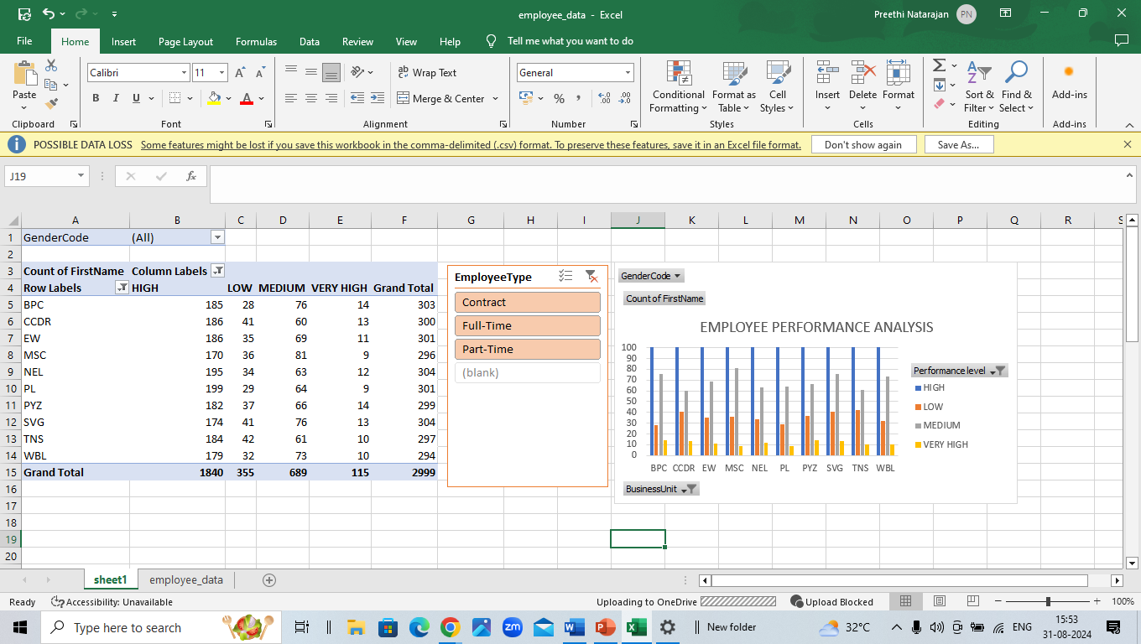
RESULTS
‹#›

Slide 18
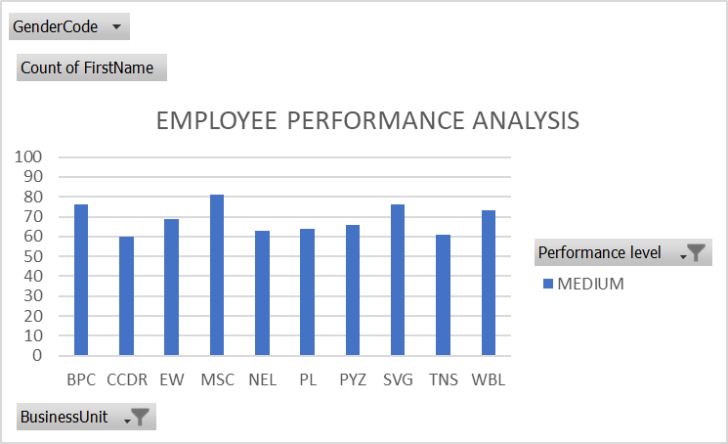

Slide 19
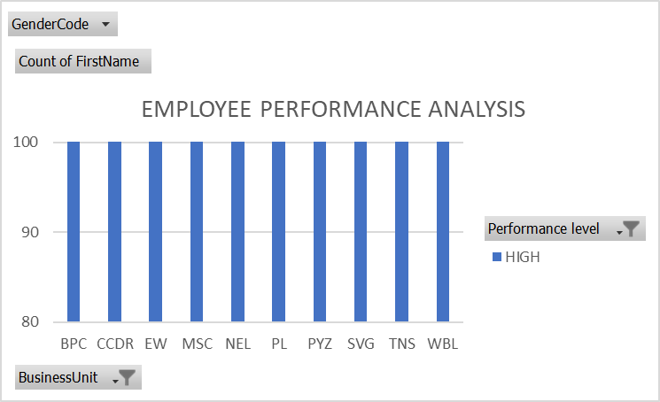

Slide 20
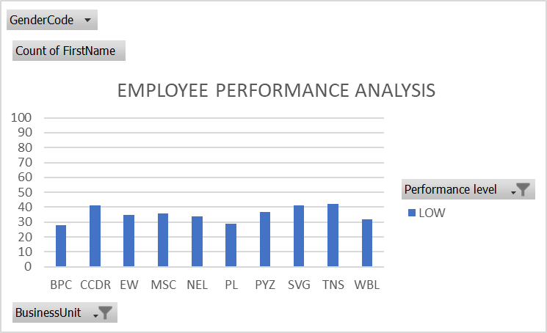

Slide 21
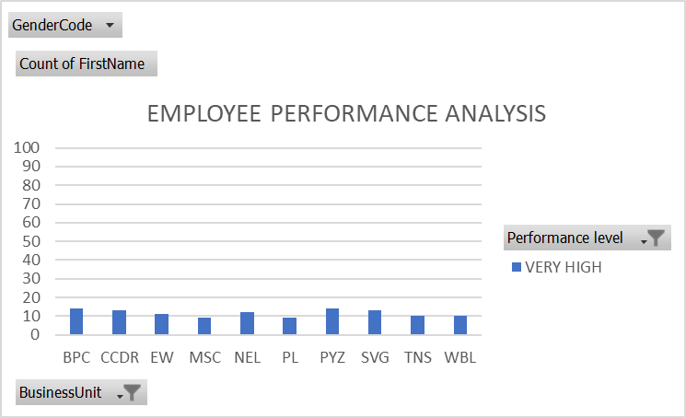

Slide 22
CONCLUSION
The employee performance analysis revealed noteworthy trends and differences between male and female employees, particularly in areas such as performance scores, ratings, and job functions. Statistical tests confirmed that some of these differences are significant, indicating potential gender-based disparities in performance evaluations. These findings suggest that current evaluation processes may unintentionally favor one gender over the other. To promote a more equitable workplace, it is recommended that the organization review and revise its performance evaluation criteria, ensuring they are unbiased and reflective of actual performance. Implementing these changes could lead to a fairer and more inclusive work environment, ultimately enhancing overall employee satisfaction and productivity.

